Slide 1
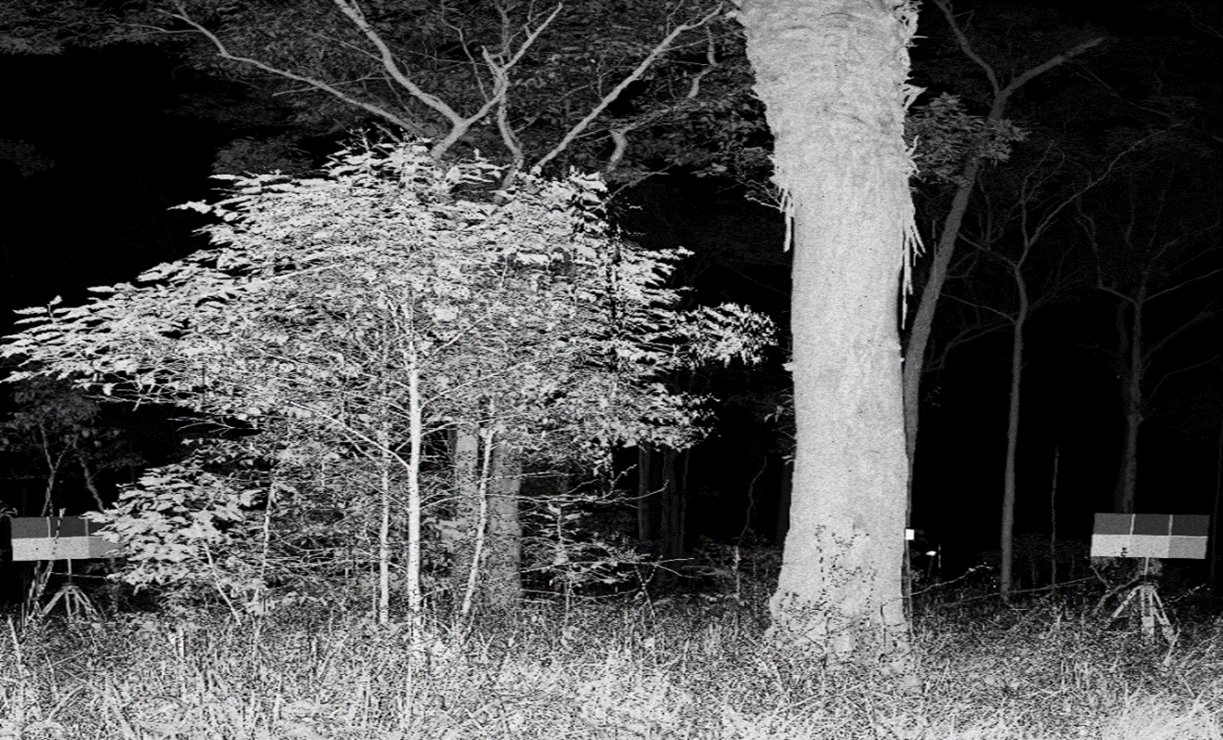
Multispectral laser scanning: an overview
Mark Danson & Fadal Sasse
Ecosystems and Environment Research Centre, School of Environment and Life Sciences, University of Salford, Manchester, UK
@SalcaSalford
Rachel Gaulton (U of Newcastle) Sanna Kaasalainen (FGI)

Slide 2
Structure of lidar waveforms
Return pulse shape ƒ outgoing pulse shape, reflectance of object, area of material in beam, angle of incidence

Slide 3
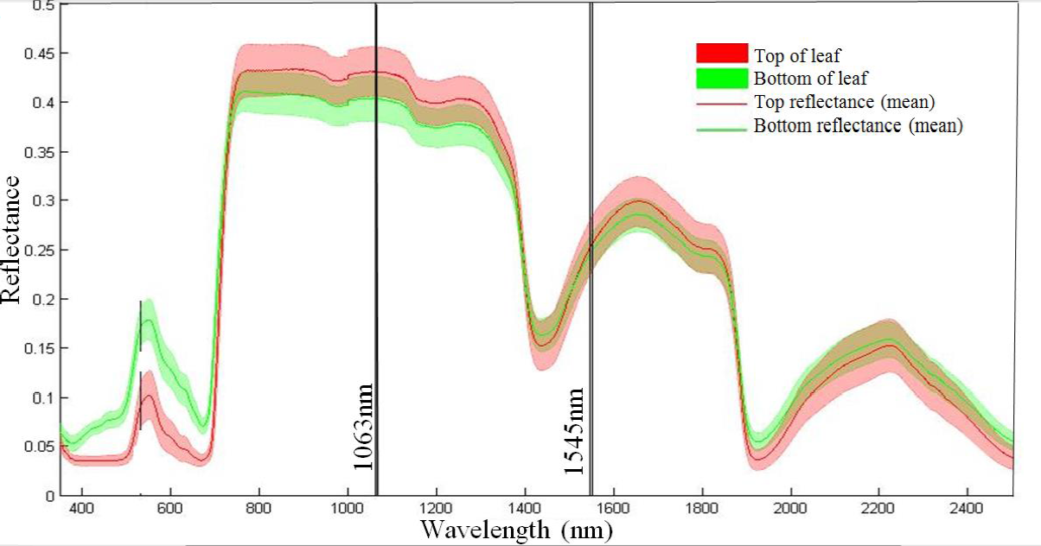
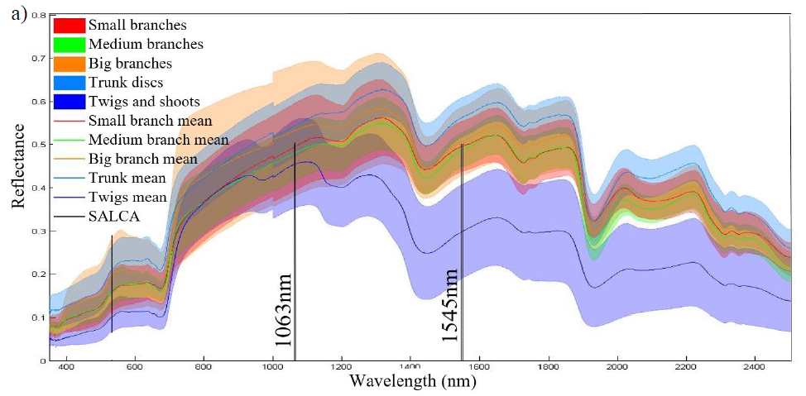
Spectral measurements of foliage and woody material
Oak leaves
Woody components

Slide 4
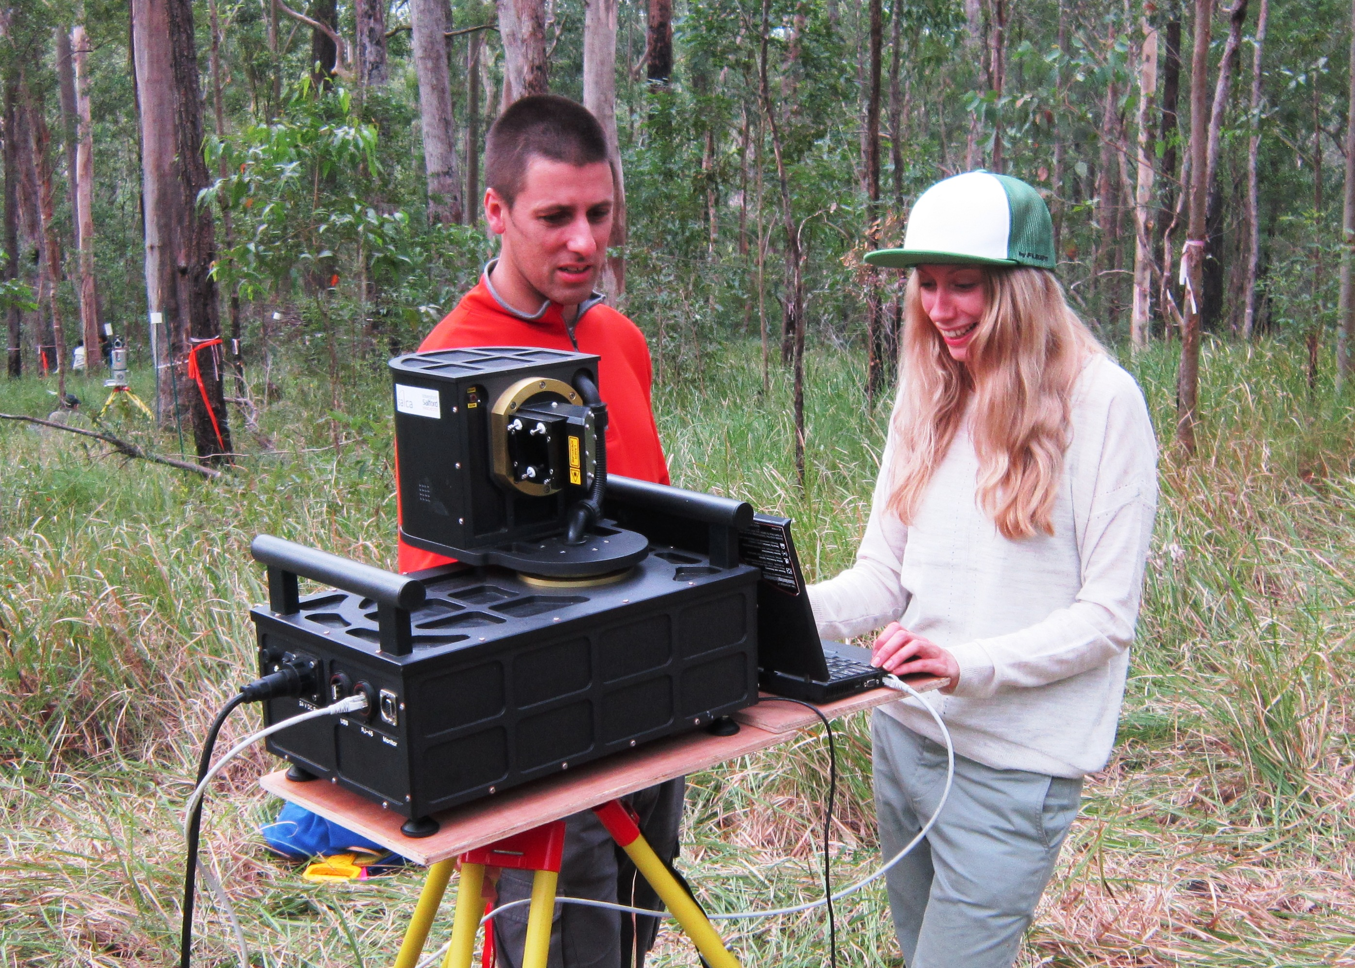
Salford Advanced Laser Canopy Analyser

Slide 5
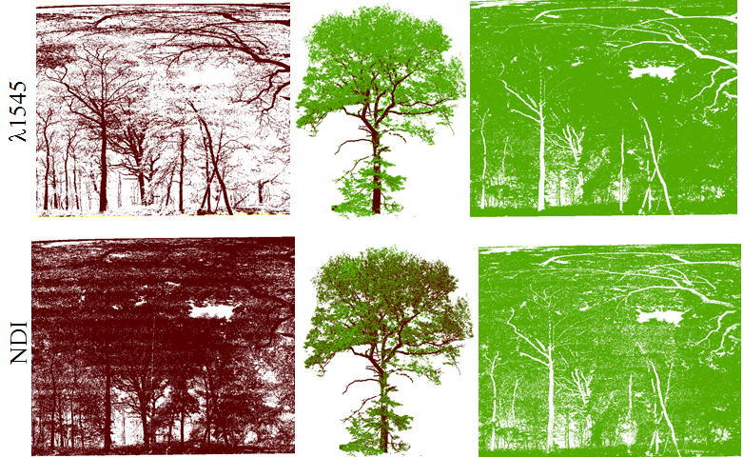
Spectral separation of foliage and woody material with SALCA
Wood only
Leaf only

Slide 6
Dual wavelength TLS for monitoring EWT of canopies

Slide 7
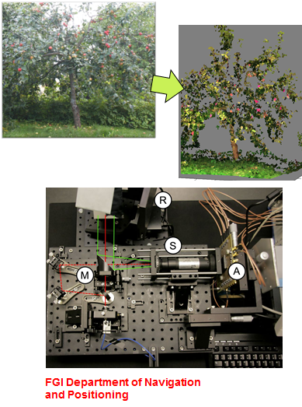
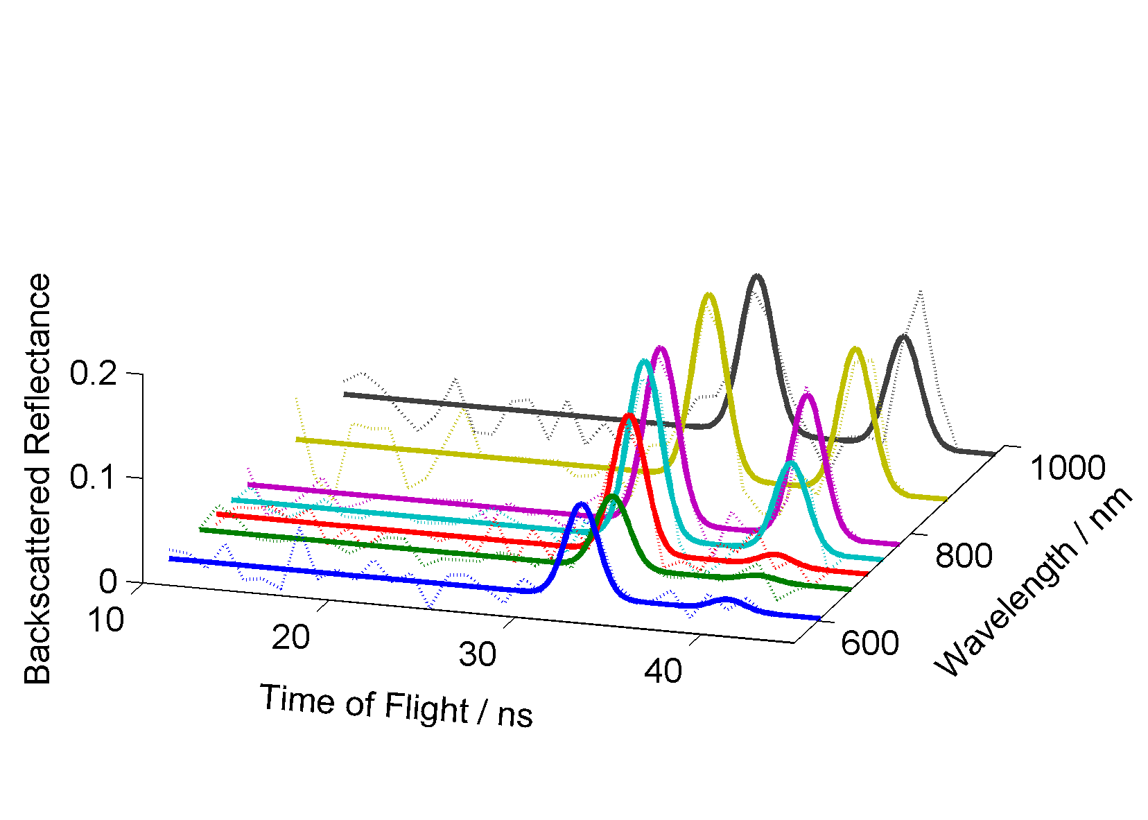
The FGI hyperspectral lidar (HSL) prototype
Automatic 3D target identification in 8 channels (about 500-1000 nm)
Supercontinuum laser light source: 1 ns pulses, 24kHz
Spectrum directly available for each point in the laser scanning point cloud

Slide 8
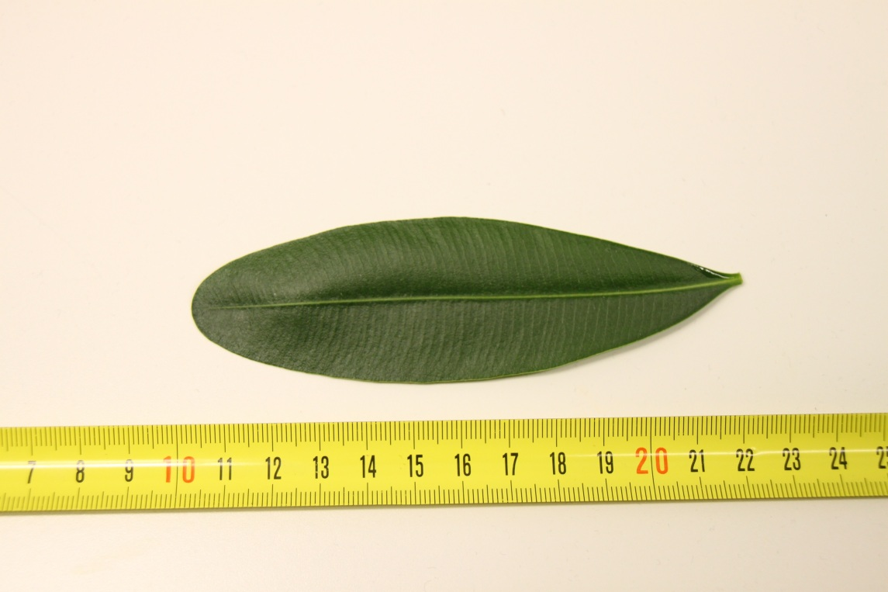
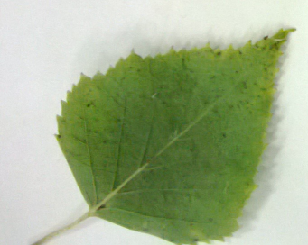
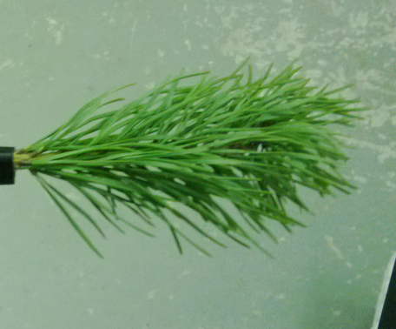
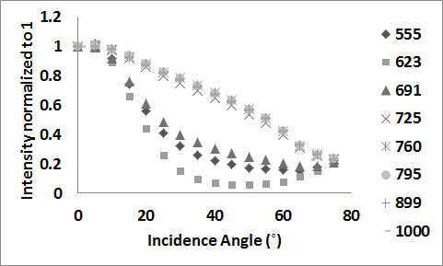
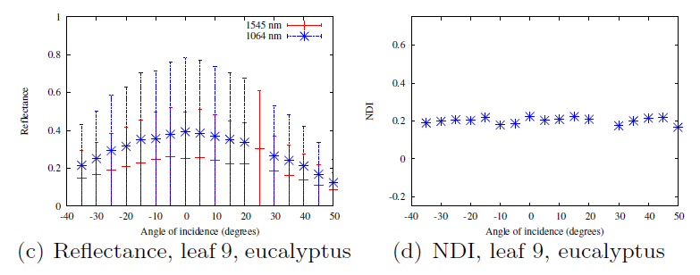
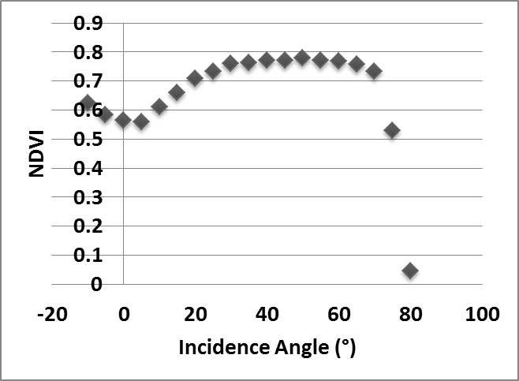
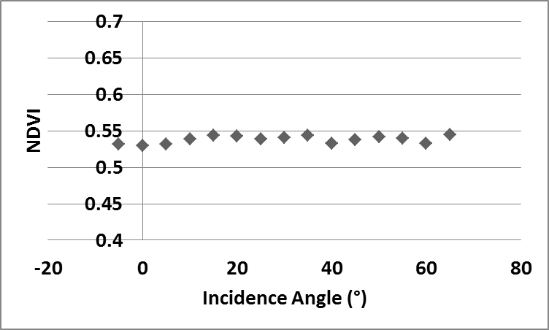
Effects of laser incidence angle
Zamioculcas, "Zanzibar Gem" (Zamioculcas zamiifolia)
Incidence angle vs. reflectance varies between visible and NIR
Variation in spectral vegetation indices, e.g., NDVI
Kaasalainen, S., et al., 2016. Incidence angle dependency of leaf vegetation indices from hyper-spectral lidar measurements. PFG Photogrammetrie, Fernerkundung, Geoinformation, 2016, Heft 2, 075-084. DOI: 10.1127/pfg/2016/0287

Slide 9
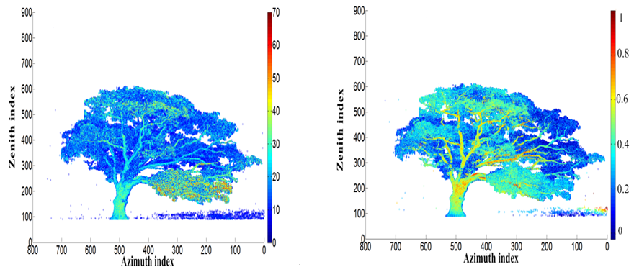
Dual-wavelength terrestrial laser scanning of forest structure and composition
Objectives:
Assess the spectral information in SALCA data in relation to tree species and composition
Use 3D spatial software (CANUPO) to assess the three-dimensional characteristics of point cloud data for tree components
Combine the spectral and spatial information in point cloud data to map forest characteristics
Intensity – 1545nm
Absolute reflectance

Slide 10
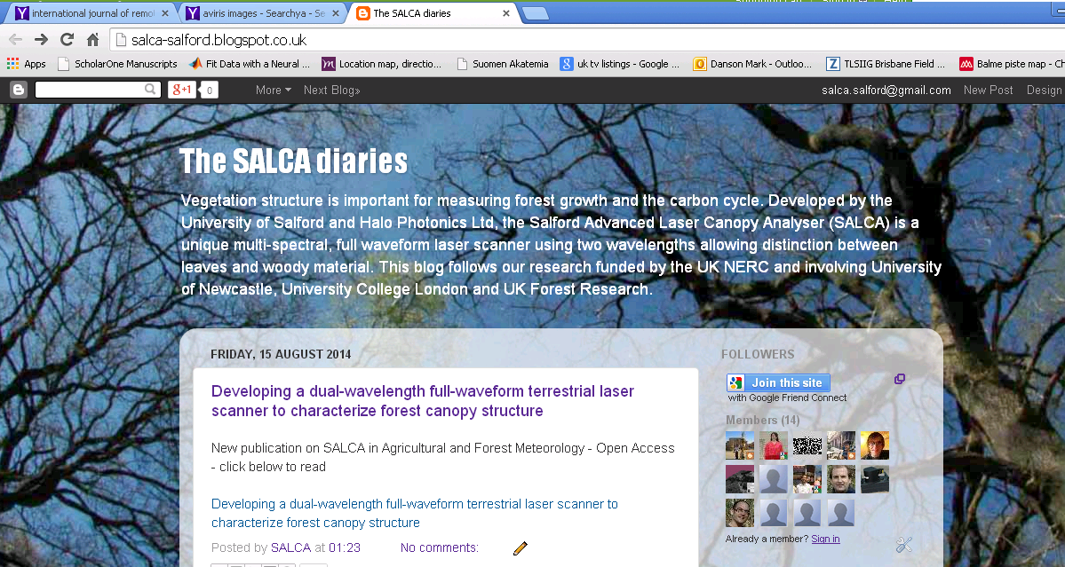
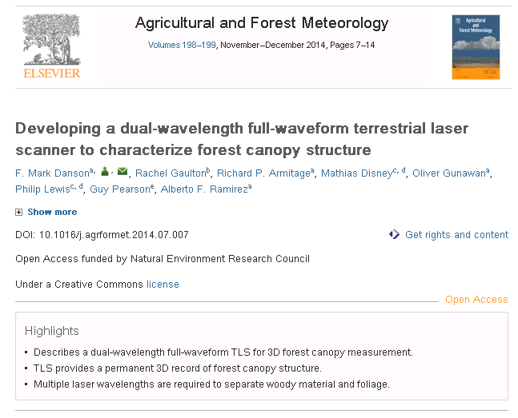
@SalcaSalford

